Slide 1
Multimedia Project
Prof. Gamal Abdel Shafy Ebrahim
CSE412: Selected Topics in Computer Engineering

Slide 2
Team Names:
Mohammed Obada Bahaa Mohammed Sarsar (16W0061)
Mostafa Ashraf Mohammed (16T0107)
Ali Sayed Mohammed Ali (1600832)
Ghada Ragab Abdelnabi (1600953)
Mariam Hamdy Abdelmaksoud Afify (1601367)
Mariam Atef Shafik (1601372)
Mary Malak Labib Eskander (1601069)
Mai AboElmaaty Mohame (1401469)

Slide 3
1. Introduction.
The content-based video retrieval has attracted the users as the use of multimedia data has been increased drastically in day-to-day life compared to text-based search. Text based search or retrieval is good when the database is small and limited.
But when it comes to huge and larger database or data warehouse, the content-based retrieval plays a vital role. Hence making the system more robust and reliable as well as automatized is necessary in the domain of CBVR system.

Slide 4
2. Detailed Project Description.
We have data consisting of images set and videos set as metadata and want to use content-based retrieval algorithms to find the data (images or videos) that is required from our metadata
If the query data was an image, we use 3 algorithms to find it and return all similar images from our database:
A- Compare by Mean Color.
B- Compare by Histogram.
C- Compare by Object detection.

Slide 5
2. Detailed Project Description.
And if the query data was a video, we use one algorithm to find it and return all similar videos from our database:
A- naive video similarity:

Slide 6
Compare by Mean Color
In this method, we compare the mean color value for the query image and the mean values of the images that are store in our database and return the index of all images that approximately equal to the query image.

Slide 7
Compare by Histogram
In this method, we compare the Histogram values for the query image and Histograms of the images that are store in our database and return the index of all images that approximately equal to the query image.

Slide 8
Color layout algorithm
It divides the whole image into sub-blocks then extract features from each sub-block or divide into regions based on features as this process is called segmentation.
This feature can be used for a wide variety of similarity-based retrieval, content filtering and visualization. It is especially useful for spatial structure-based retrieval applications.

Slide 9
naive video similarity
A video similarity measure that is based on the percentage of visually similar frames between two sequences.
A naive way to compute such a measure is to first find the total number of frames from each video sequence that have at least one visually similar frame in the other sequence.
And then compute the ratio of this number to the overall total number of frames.
The number of comparisons can be reduced by selecting frames in each video sequence that are

Slide 10
Beneficiaries of The Project
This project for anyone who wants to search for something by image and gets images like one he has or has part of the video and wants to search for similar videos.
For example, if he wants a photo for a certain flower and has its image could find other flower images by this project or if he has a scene of a movie and needs the whole movie.

Slide 11
Task Breakdown Structure
We divide the whole project into four tasks which are:
The first part is image features extraction with its three algorithms which are Mean color, histogram and color layout algorithm.
The second part is video features extraction with one algorithm which is naive video similarity.
The third part is database.
The fourth part is the GUI which is desktop application by using python.
Then the integration of the four parts.
All of us contributed to writing the documentation.
We work together on each part of the project.

Slide 12
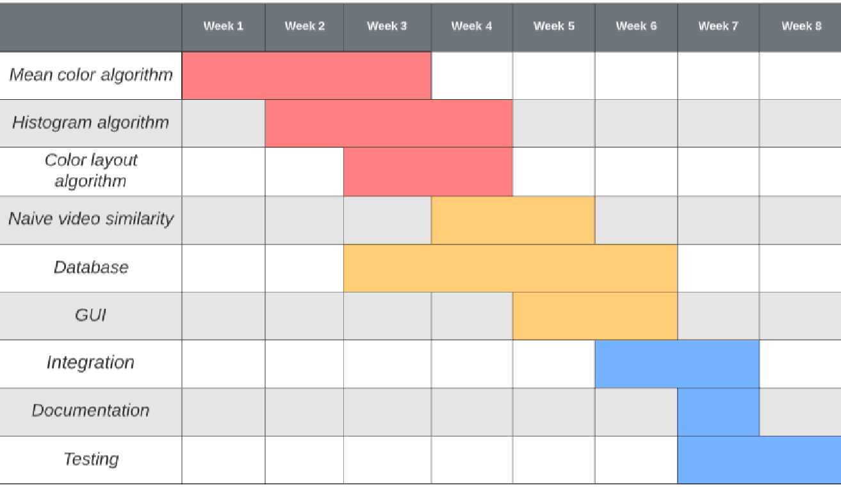
Time Plan of The Project

Slide 13
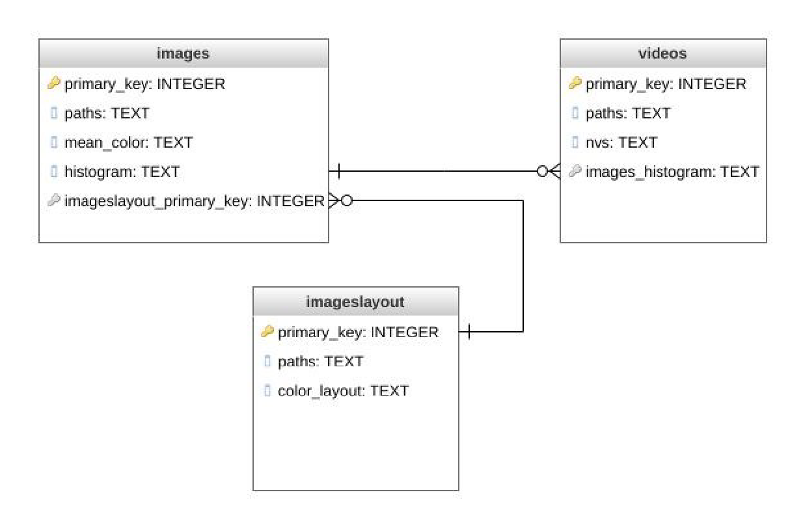
Multimedia Database Design

Slide 14
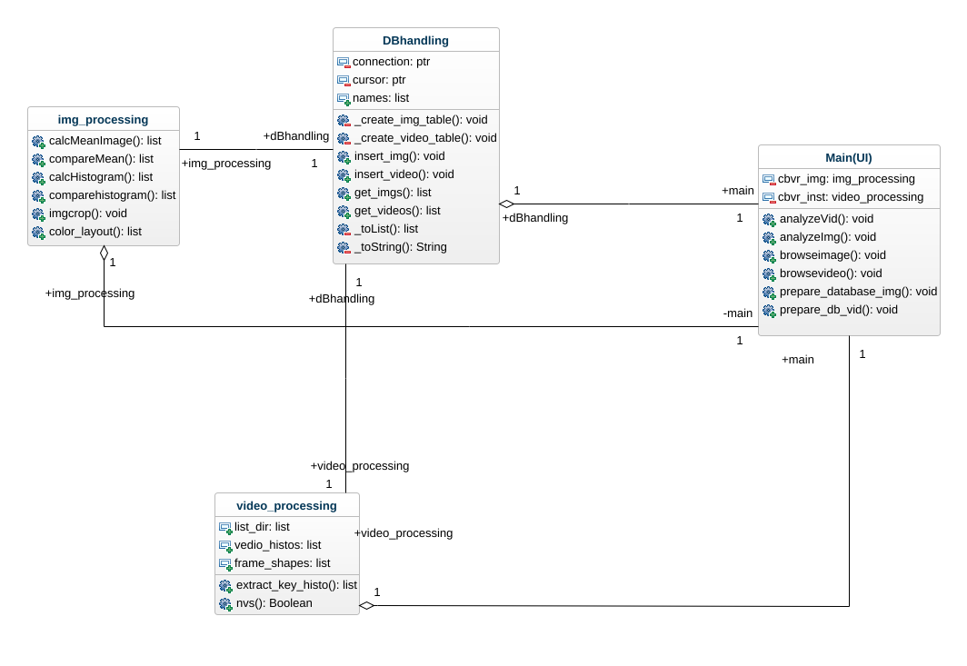
System Design

Slide 15
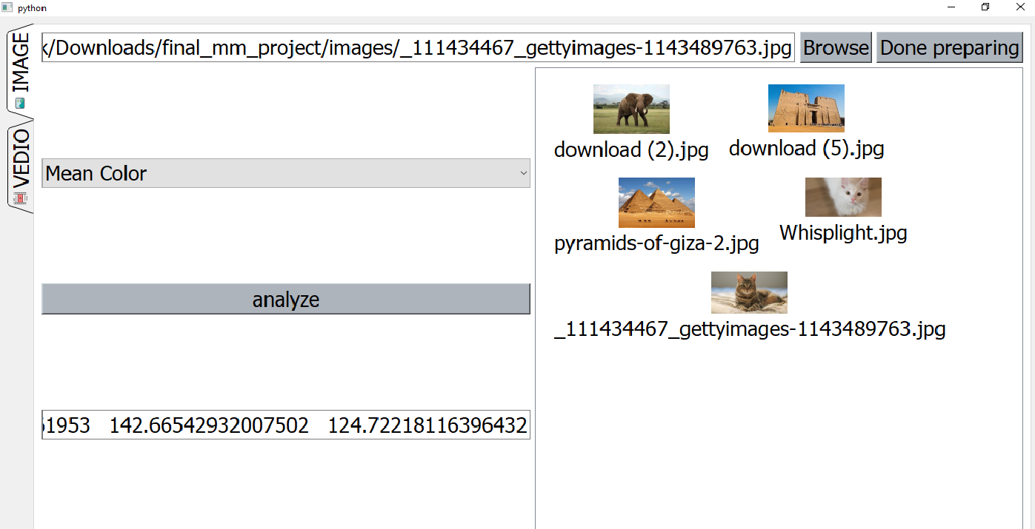
Testing Scenarios and Results
“Searching for an image by mean color”

Slide 16
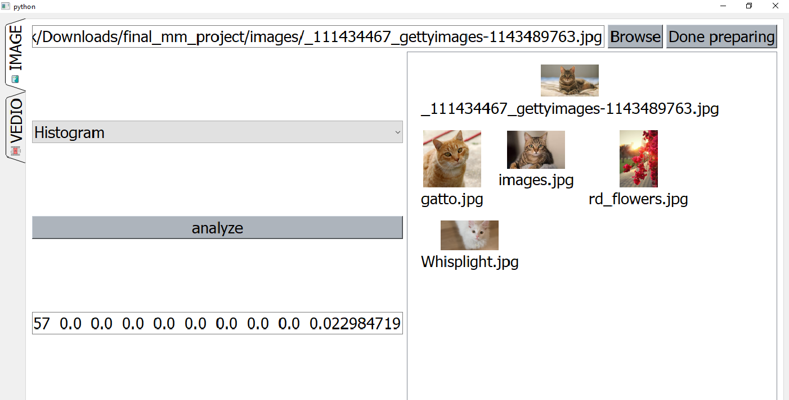
Testing Scenarios and Results
“Searching for an image by histogram”

Slide 17
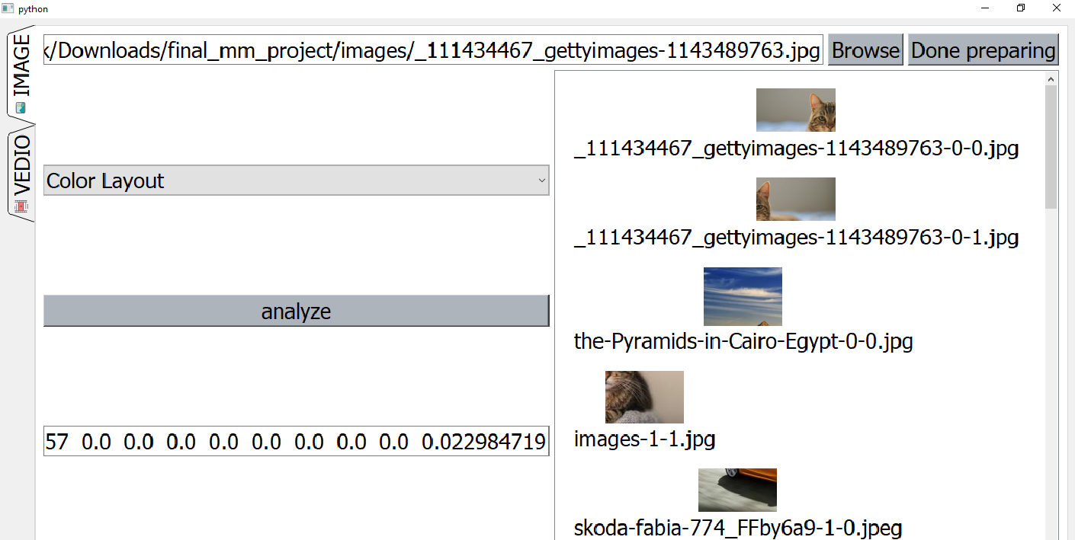
Testing Scenarios and Results
“Searching for an image by color layout”

Slide 18
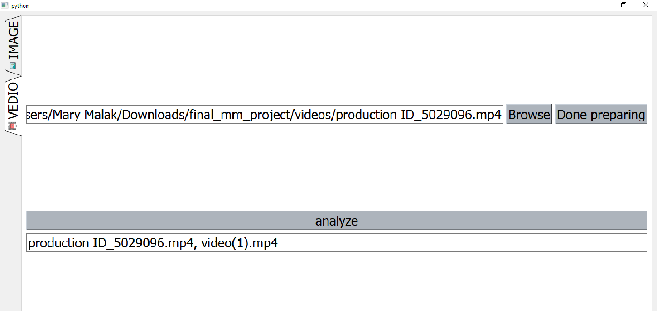
Testing Scenarios and Results
“Searching for a video”

Slide 19
Conclusion
Numerous researches have been accomplished in the CBIR field, it has further to go to supply the users with resources to extract images out of the image or multimedia databases in a really effective method giving input by means of image, text or drawing.
The main aim of this work is to investigate an approach to using objects for video retrieval and a set of experiments was developed in order to explore some issues related to this.
In this section are discussed the main findings of this research.
Experimental results indicate that object-based search overall outperforms the image-based search for the set of topics used here. However, there are search topics that are not well suited to object-based retrieval.

Slide 20
References
1. M. Mandal, Multimedia Signals and Systems, Kluwer Academic ,Publishers, 2003.
2. A. Puri, Multimedia Systems, Standards and Networks, Taylor and Francis, 2007.
3. K. R. Rao, Z. S. Bojkovic, and D. A. Milovanovic, Multimedia Communication Systems, Prentice Hall, 2002.
4. F. Halsall, Multimedia Communications, Addison Wesley, 2001

